Slide 1
Tripeerz
Provided by: Dennis Wong Chu Ho

Slide 2
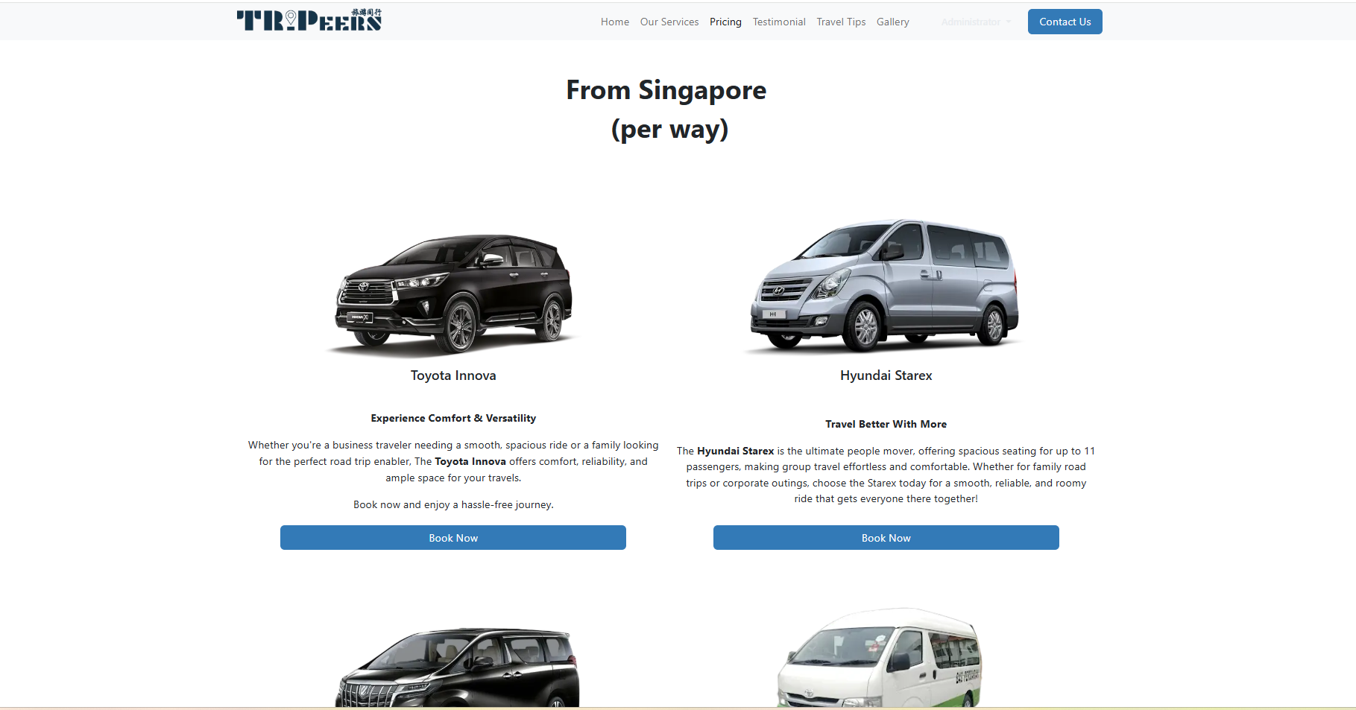
Suggestion:
For Pricing Page, there are couple of suggestion involved in this. This one would be either remain or becoming information with just 1 clickable button to access to booking now.
Depending on this pricing page, there are other things need to be changed which the consumer would make more sense. Look at the next page for booking session.

Slide 3
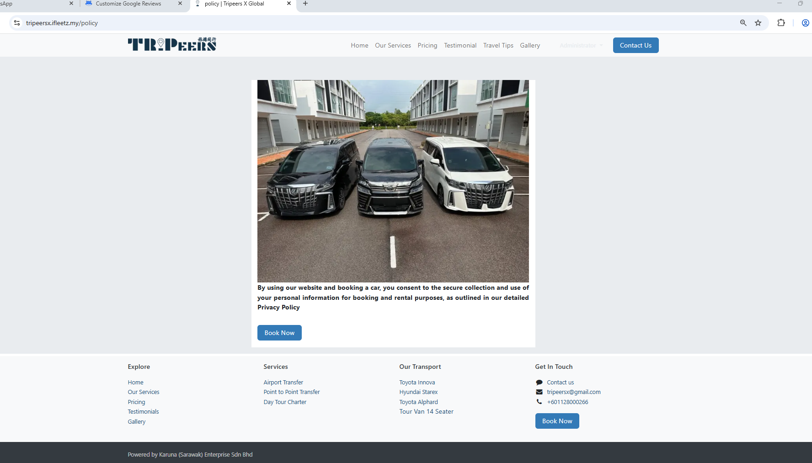
Suggestion:
Before going to booking page, this page is for what purpose??
For better suggestion, this one should be removed OR set it under the page of pricing with some kind of popup before going direct to the booking page instead.

Slide 4
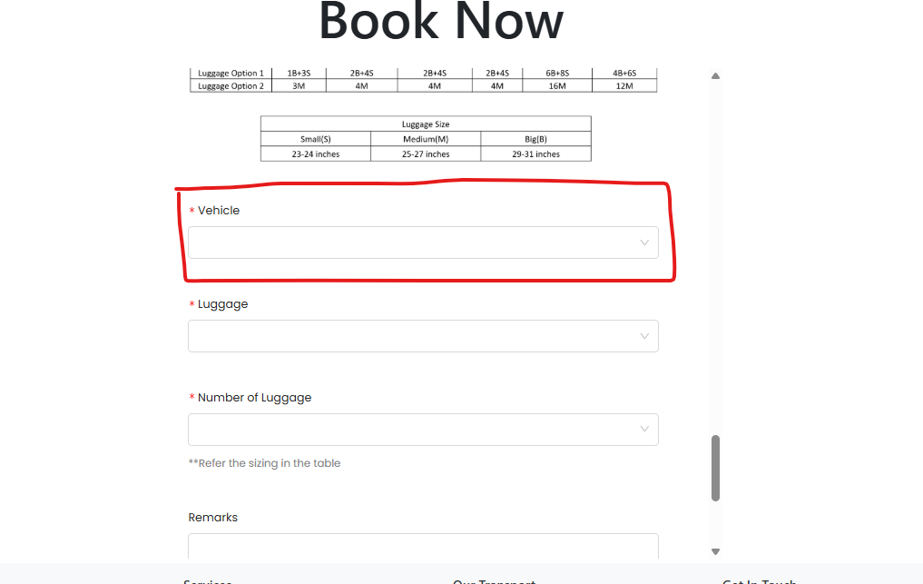
Suggestion
In this section, improvement is required. Because of the previous page has each button for every car, this dropdown should not be able to select since a user choosing the car on that side already, they don’t have to refill from here which is automatically.
Unfortunatelly this code is under another platform to change, it is very high possible that cannot be linked. (advised)

Slide 5
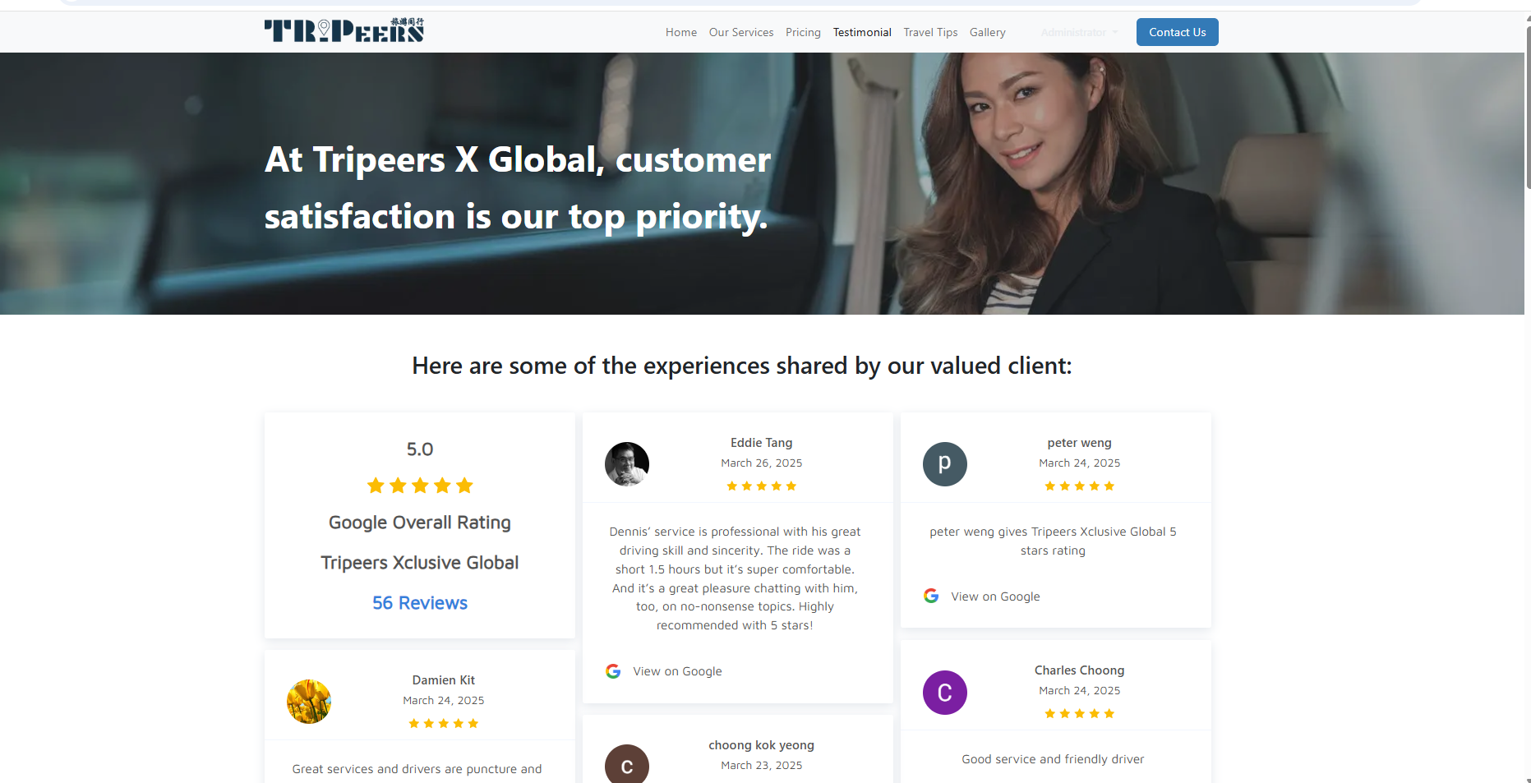
Suggestion
Testimonial part:
The limitation is around 30 views with the review part. So far there is no suggestion for adding more views unless been requested. But if requested, the free version cannot be used due to limitation so have to use pay version to edit.

